Slide 1

Subject Code:S614PT1
PT II - INTERDISCIPLINARY PROJECT
PREDICTIVE MODELING FOR CREDIT CARD FRAUD DETECTION
Dharanesh.M.M.[42733020]
Internal Guide
Dr. S. Vigneshwari, M.E., Ph.D.,

Slide 2
PRESENTATION OUTLINE
ABSTRACT
OBJECTIVES
SYSTEM ARCHITECTURE
PROJECT IMPLEMENTATION
CONCLUSION & FUTURE WORK
REFERENCES

Slide 3
ABSTRACT
The Credit Card Fraud Detection System (CCFDS) is a web-based application designed to efficiently detect fraudulent activities in credit card transactions. Using a Logistic Regression model trained on a Kaggle dataset, the system helps classify transactions as fraudulent or legitimate, minimizing financial losses and enhancing payment system security. It addresses a significant challenge for banks, financial institutions, and e-commerce platforms by detecting suspicious activities in real time. Key features include a simple interface for transaction input, data protection, and fast fraud prediction. The system analyzes transaction attributes like amount and time, combined with anonymized data, to provide rapid and accurate fraud detection. By predicting trends, CCFDS enables organizations to take proactive measures, safeguarding user assets and fostering trust in digital financial platforms.

Slide 4
OBJECTIVES
Enhance Fraud Detection Efficiency: Develop an online platform to provide real-time fraud detection for credit card transactions, leveraging machine learning to classify transactions and minimize financial losses while enhancing the security of payment systems.
Streamline Transaction Monitoring: Implement a user-friendly interface for transaction input and analysis, allowing financial institutions to easily monitor, flag, and manage suspicious activities while protecting sensitive data.
Proactive Fraud Prevention: Introduce predictive analytics to identify fraud patterns, enabling organizations to take preventive actions and mitigate risks, fostering trust and security in digital financial platform
Facilitate User Insights: Integrate a system that provides instant feedback on fraud detection outcomes, helping users quickly understand the status of transactions and promoting confidence in secure online transactions.

Slide 5
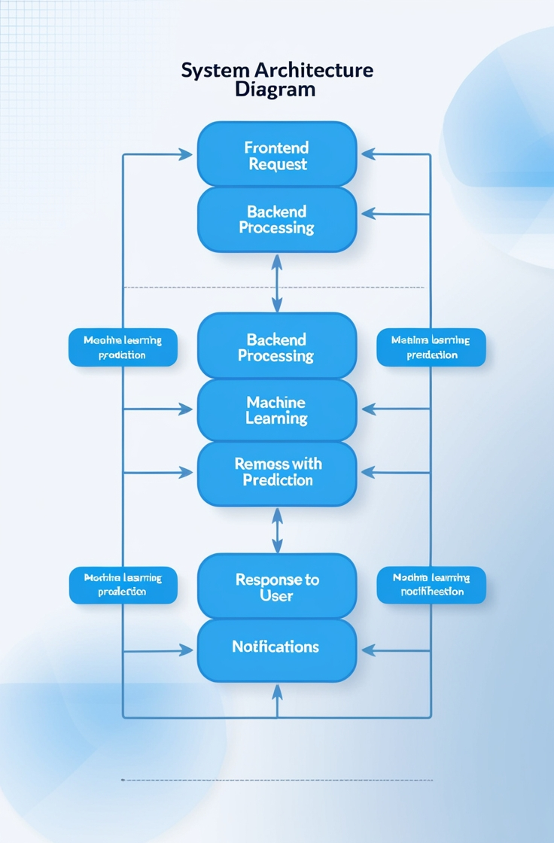
SYSTEM ARCHITECTURE
User Interaction: User inputs transaction details or checks fraud detection results on the platform.
Frontend Request: Sends transaction data and user actions to the FastAPI
Backend Processing: FastAPI calls the fraud detection model for predictions.
Machine Learning Prediction: The pre-trained Logistic Regression model analyzes the transaction and classifies it as fraudulent or legitimate.
Response to User: Backend sends results to update the UI.
Notifications: Sends reminders via email/SMS at scheduled times.

Slide 6
HARDWARE AND SOFTWARE REQUIREMENTS
Software Requirements
Programming Languages: Python, jupyter notebook, JavaScript
Frameworks: FastAPI or React.js (Frontend)
Editor: Visual Studio Code, PyCharm, or any preferred code editor
Machine Learning Libraries: Scikit-learn, joblib (for loading pre-trained models)
Hardware Requirements
Any Operating System
Storage: Minimum 10 GB free disk space for software and database files
Internet: Stable internet connection for API integrations (email, SMS, chatbot services

Slide 7
Front-End Implementation
React Js: CSS, Java Script, Node modules, Node Js,
UI Design:
Fraud Prediction Results: Dynamic display of fraud detection results with clear indications of whether a transaction is classified as fraudulent or legitimate.
Transaction Input Form: An interactive form built using React.js, allowing users to input transaction details such as amount, time, and description for fraud analysis.
API Integration: React.js uses the fetch API or Axios to communicate with the FastAPI backend, handling tasks like transaction submissions, retrieving fraud detection predictions, and managing user notification preferences.

Slide 8
Back-End Implementation
Backend Framework: Python with FastAPI for handling fraud detection requests and connecting to the Logistic Regression model for transaction classification.
Fraud Detection Model: Logistic Regression model integrated into FastAPI to predict fraudulent transactions based on input data.
Real-Time Transaction Monitoring: FastAPI routes handle CRUD operations for transaction records, allowing real-time fraud detection and tracking.
Data Analysis: Provides insights into fraud trends and statistics, helping identify patterns in fraudulent activities.
Real-Time Transaction Monitoring: FastAPI routes handle CRUD operations for transaction records, allowing real-time fraud detection and tracking.
User Authentication and Authorization: Secure user login system with token-based authentication to ensure only authorized users can access transaction records and perform actions.

Slide 9
CONCLUSION & FUTURE WORK
Conclusion:
This project presents an online credit card fraud detection system that facilitates real-time transaction monitoring, and provides comprehensive fraud data analysis. Developed using Python, FastAPI, and Logistic Regression, the application ensures efficient fraud detection while prioritizing user data security and accuracy in prediction.
Future Work:
Database Integration: Implement a database (SQLite/MySQL) to store user details, transaction history, and fraud detection outcomes.
Chatbot: Add a chatbot to help users check transaction statuses and provide fraud-related assistance
.Mobile App: Develop a mobile app for real-time fraud monitoring and alerts.
Email Notifications: Set up an email notification system to alert users of suspicious transactions.

Slide 10
REFERENCES
Zareapoor, M., & Shamsolmoali, P. (2015). "Application of credit card fraud detection: Based on anomaly detection system." Procedia Computer Science, 48, 679-685.
Ngai, E. W., Hu, Y., Wong, Y. H., Chen, Y., & Sun, X. (2011). "The application of data mining techniques in financial fraud detection: A classification framework and an academic review of literature." Decision Support Systems, 50(3), 559-569.
Bhattacharyya, S., Jha, S., Tharakunnel, K., & Westland, J. C. (2011). "Data mining for credit card fraud: A comparative study." Decision Support Systems, 50(3), 602-613.
Bolton, R. J., & Hand, D. J. (2002). "Statistical fraud detection: A review." Statistical Science, 17(3), 235-255.
Dal Pozzolo, A., Caelen, O., Le Borgne, Y. A., Waterschoot, S., & Bontempi, G. (2014). "Learned lessons in credit card fraud detection from a practitioner perspective." Expert Systems with Applications, 41(10), 4915-4928.

Slide 11

PREDICTIVE MODELING FOR CREDIT CARD FRAUD DETECTION

Slide 12

PREDICTIVE MODELING FOR CREDIT CARD FRAUD DETECTION

